Slide 1
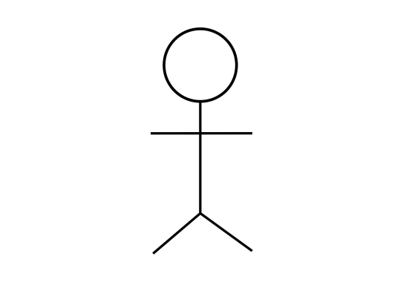
Tea Coffee Vending Machine
Select Product
Choose Quantity
Make Payment
User
Refill Container
Generate Report
Reset Container
Exit

Slide 2
TeaHelper
isDelivered
isEnoughMaterial
TeaCoffeeVendingFactory
TeaHelper()
CoffeeHelper();
BackTeaHelper();
BlackCoffeeHelper();
BlackTeaHelper
isDelivered()
isEnoughMaterial()
BlackCoffeeHelper
CoffeeHelper
isDelivered()
isEnoughMateria
()
isDelivered()
isEnoughMaterial()

Slide 3
CheckTotalSale
ContainerStatus
RefillContainer
ResetContainer
WasteMaterialH
containerStatus()
getWasteMaterial()
addTotalSale()
updateTotalCost()
writeTotalCost()
refillConatiner()
resetContainer()
consumeContainer()
addWasteMaterial()
updateConatiner()
updateWasteMaterial()
writeContainer()
writeContainer()
resetContainer()

Slide 4
MaintenanceFactory
RefillContainerHelper()
CoffeeHelper()
BackTeaHelper()
CheckTotalSaleContainerHelper()
ContainerStatusHelper()
RefillContainerHelper
ResetContainerHelper
ContainerStatusHelper
checkContainerStatus()
checkContainerStatus()
checkContainerStatus()
checkContainerStatus()
checkContainerStatus()

Slide 5
Launch / User
Main Menu
Delegate
Factory
Helper
Model
JSON Stored
Select Item
Call Devlivery Method
Item details
Stored JSON Object
Return is delievery made successfully ?
Retrive Stored JSON Object
Display amount
Insert coin

